Slide 1
Classification of Electronic Music Genres using Py Spark ML-lib
Leveraging Big Data Tools for Music Recommendation
Ashutosh Anand – 202318035
Kunal Anand – 202318057
Anjali Singh – 202318050 DAIICT, Gandhinagar

Slide 2
Introduction & Problem Explanation
Introduction to the Problem:
"Classifying music by genre is a challenging yet crucial task in the music industry. With the vast array of electronic music styles, accurately identifying genre from audio features is not straightforward. This classification is complicated due to the subtle differences and significant overlap between various electronic music genres."
Importance:
"Genre classification plays a pivotal role in music recommendation systems like Pandora. It helps in curating personalized playlists, enhancing user experience by matching their taste and discovering new music aligned with their preferences. Efficient genre classification ensures users remain engaged and satisfied, thereby increasing platform loyalty and usage."
Objective:
"The objective of this project is to utilize PySpark MLlib, a powerful tool for handling big data, to classify songs into 23 distinct electronic music genres. By leveraging the scalable nature of PySpark, we aim to process and analyze large datasets of audio features to build an accurate and robust music genre classification model."

Slide 3
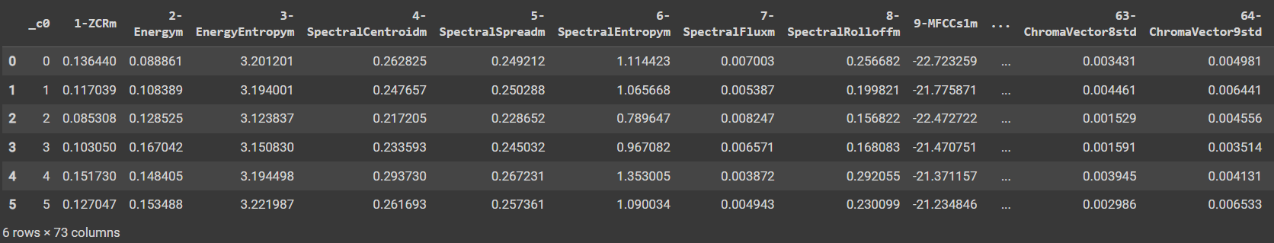
Background on Electronic Music
Diversity of Genres: Electronic music is characterized by a wide range of genres each with unique styles and soundscapes. From house to techno, drum & bass to ambient, each genre has distinctive elements that appeal to different audiences.
Complexity in Classification: Due to overlapping sound characteristics and the subjective nature of music, accurately classifying these genres presents a significant challenge.
Data Overview
Dataset Composition: The dataset consists of the top 100 songs from 23 different electronic music genres, representing a diverse collection of electronic music.
Feature Extraction: Audio features were extracted using pyAudioAnalysis from two-minute samples of each song. This includes basic spectral features, rhythm-related features, and MFCCs (Mel Frequency Cepstral Coefficients).

Slide 4
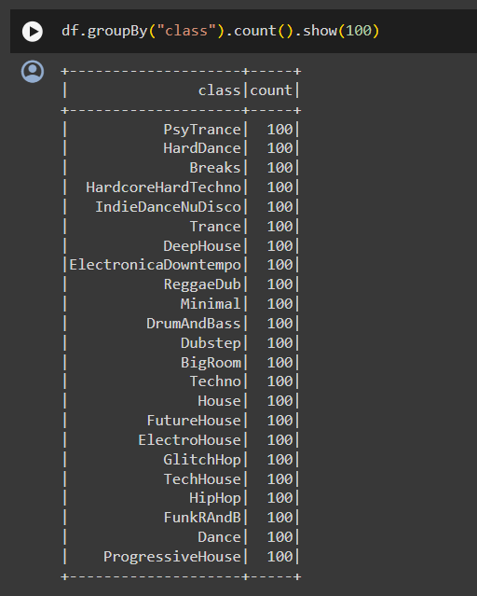
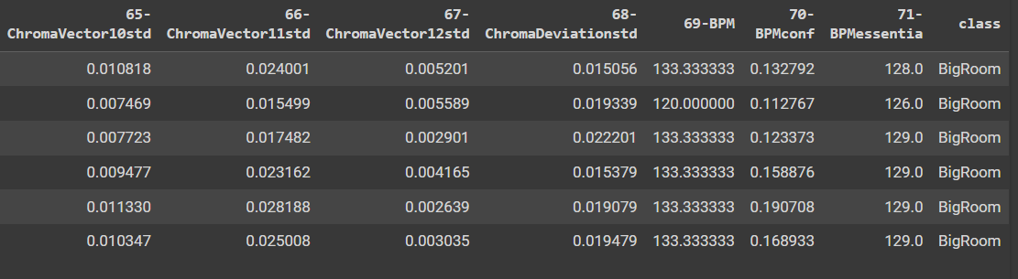
Tools Used
PySpark MLlib: An advanced analytics library within Apache Spark, providing scalable machine learning algorithms.
Relevance to Big Data: PySpark is ideal for this project due to its ability to handle large datasets efficiently, perform complex transformations, and build scalable machine learning models, making it suitable for real-time recommendation systems.

Slide 5
Solution Techniques
1. Baseline Model
Objective: Establish a benchmark for model performance without data preprocessing.
Approach: Train the model on raw data to assess the impact of subsequent data treatments and feature selection.
Outcome: Provides a clear understanding of how much preprocessing and feature engineering can improve the model's predictive capabilities.
2. Data Treatment
Issues Addressed: Original dataset may contain outliers, skewed distributions, and negative values that can distort the predictive model's performance.
Techniques Used:
Outliers: Implement robust scaling or trimming methods to reduce the influence of extreme values.
Skewness: Apply transformations such as log, square root, or Box-Cox to normalize data distributions.
Negative Values: Use absolute values or scaling methods to handle negative measurements appropriately, ensuring all input features are non-negative as required by specific algorithms.
Impact: Improved model accuracy and reliability by ensuring the data conforms to necessary statistical assumptions.
3. Feature Selection
Purpose: Enhance model performance by selecting the most informative features and reducing dimensionality.
Methods Applied:
Chi-Squared Test: For categorical features, measure the dependence of the target on each predictor to retain the most significant relationships.
Recursive Feature Elimination: Iteratively construct models and remove the least significant feature until the desired number of features is reached.
Importance Scores from Ensemble Methods: Use Random Forest and Gradient Boosting Trees to gauge feature importance based on how often they appear in decision paths.
Benefits: Reduces overfitting, speeds up training, and improves model interpretability by focusing on relevant attributes.

Slide 6
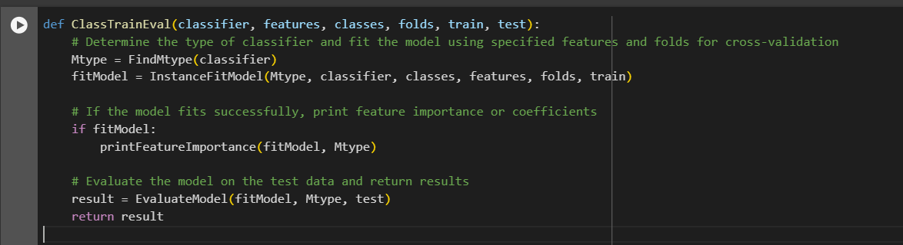
Code Snippet for Training and Evaluation Function
Explanation:
FindMtype: Identifies the type of model (e.g., Logistic Regression, Decision Tree).
InstanceFitModel: Configures and fits the model using cross-validation to optimize parameters.
printFeatureImportance: Outputs the importance or coefficients of features to understand their impact on the model.
EvaluateModel: Tests the model's performance on unseen data and calculates accuracy.

Slide 7
Implementation - Model Testing
Setting Up Testing Environment
Data Preparation:
Input Variables: Selected all columns except the first and last as features.
Target Variable: Set as 'class'.
Classes Count: Retrieved the number of unique classes in the dataset to decide on the evaluation strategy.
Model Testing: Test 1 (Baseline without Outlier Treatment)
Objective: Establish a baseline performance without outlier, skew, or negative value treatment to understand the effects of such treatments in subsequent tests.
Method:
Data Preparation: Data was preprocessed without treating outliers or negative values, thus excluding classifiers sensitive to negative values like Naive Bayes.
Classifier Setup: Multiple classifiers were tested, including Logistic Regression, OneVsRest, Linear SVC, RandomForest, GBT, Decision Tree, and Multilayer Perceptron.
Data Splitting: The dataset was split into training (70%) and testing (30%) sets.

Slide 8
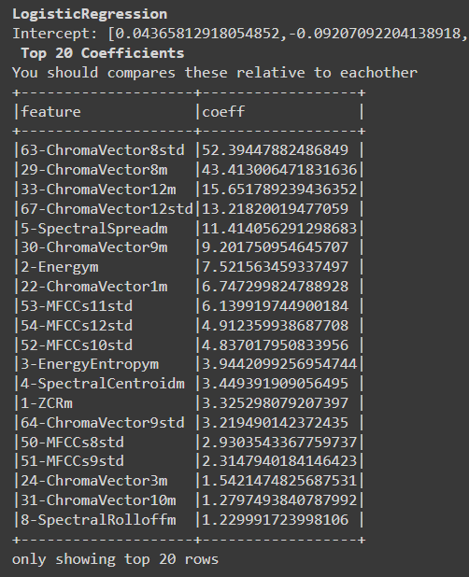
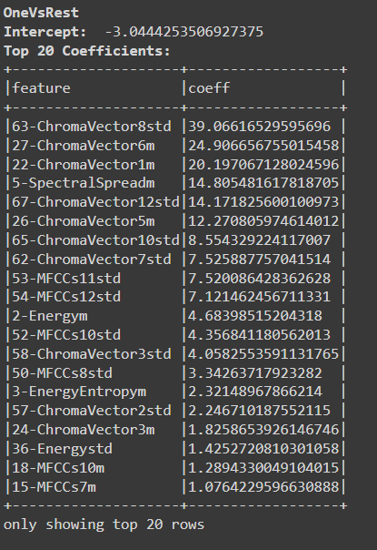
[ ]
Challenges and Solutions
Challenge 1: High dimensionality of data impacting performance and training time.
Solution: Feature selection to reduce dimensionality in subsequent tests.
Challenge 2: Class imbalance possibly skewing the performance metrics.
Solution: Planning to implement SMOTE or similar techniques in future tests to balance the dataset.

Slide 9
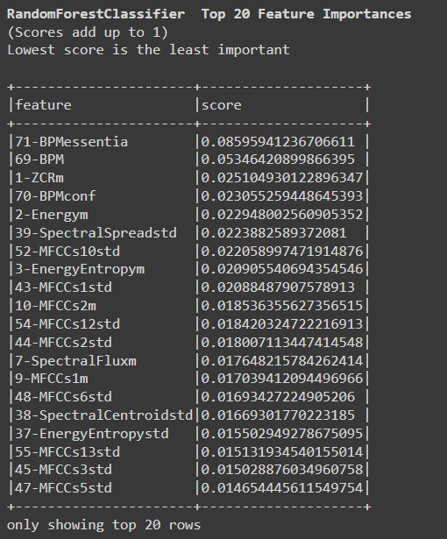
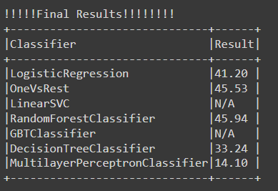
Results: Test 1 Overview
Logistic Regression:
Intercept and Coefficients: Displayed key coefficients indicating influential features.
Top Features: ChromaVector and MFCCs (Mel-frequency cepstral coefficients) were significant predictors.
OneVsRest:
Intercept and Coefficients: Different feature set importance highlighted for decision-making.
Top Features: Similar to Logistic Regression with some differences in feature importance.
Key Takeaways
Initial Insights: The baseline model without any data treatment provided a clear insight into how raw data performs, setting a benchmark for comparing further refined models.

Slide 10
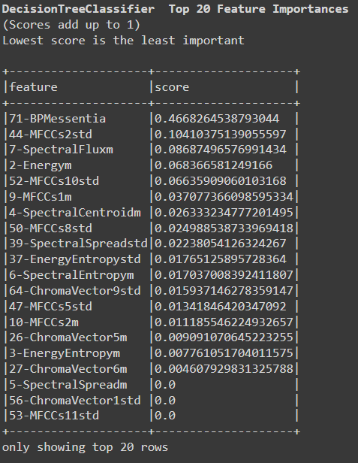
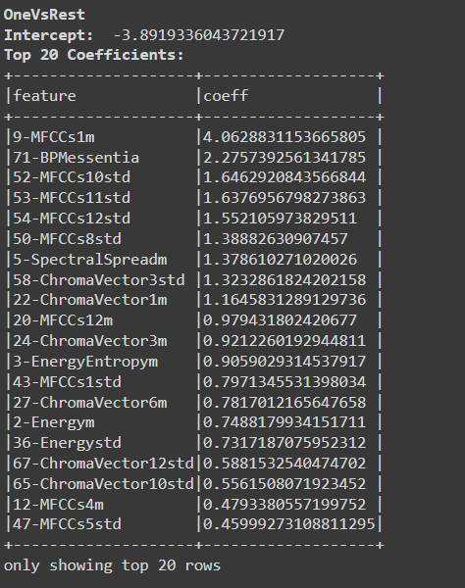
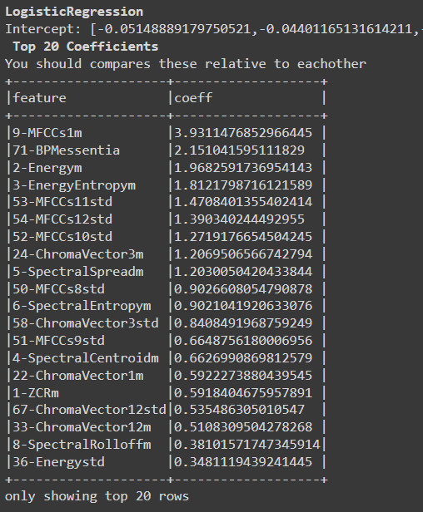
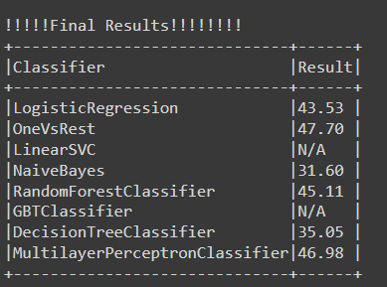
Test 2 (Treated Data):
Objective:
Goal: Enhance model accuracy by addressing data anomalies such as outliers, skewness, and negative values.
Data Preprocessing:
Outliers & Skewness: Applied trimming and transformations (e.g., log or square root) to normalize data distribution.
Negative Values: Adjusted to meet model requirements, using scaling or shifting methods.
Naive Bayes Consideration:
Initial Omission: Excluded initially due to its requirement for non-negative features.
Inclusion After Preprocessing: Included after adjusting data to remove negative values, aligning with model assumptions.
ance fairly against other models.

Slide 11
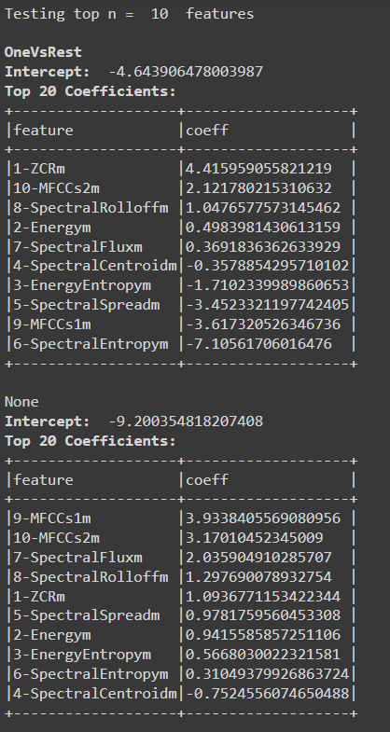
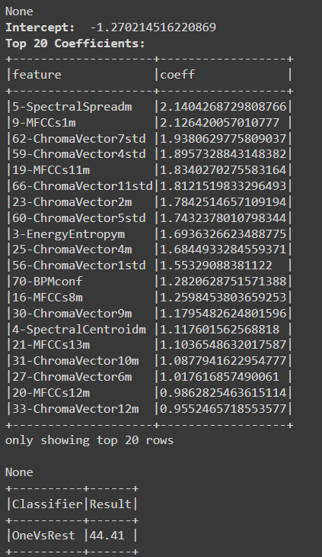
Test 3 (Feature Selection):
Objective:
Aim: Boost model performance by employing feature selection techniques.
Process:
Technique Used: Chi-Squared Selector was deployed to identify the most significant features from the dataset.
Impact on Model: This feature selection directly influenced the performance of the One vs Rest classifier that uses Logistic Regression as the underlying algorithm. By focusing on the most relevant features, the model could train more effectively, potentially increasing accuracy and reducing overfitting.
Fine-Tuning:
Optimization: Tested various numbers of features to find the optimal subset
for model training. This approach allowed us to refine the model by incrementally
adjusting the number of features included, thereby observing the effects on
performance metrics like accuracy and model complexity.

Slide 12
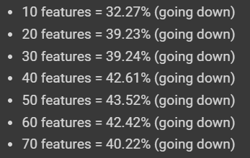
Results and Analysis
1. Performance Metrics:
Initial Baseline Accuracy: Using all 71 features, the initial model achieved an accuracy of 45.94%.
Feature Reduction Tests:
2. Comparison:
Impact of Feature Selection:
The tests with reduced features consistently resulted in lower accuracy compared to using all 71 features.
Accuracy decreases as the number of features is reduced from 71 down to 10.
Variability and Consistency:
There is noticeable variability in performance as the number of features changes.
No configuration of reduced features was able to surpass the baseline performance using all 71 features.
3. Insights and Findings:
Optimal Feature Set:
The best accuracy is achieved using the full set of 71 features, indicating that each contributes valuable information for genre classification.
Feature Selection Takeaway:
Reducing the number of features under 71 tends to decrease the model’s performance, suggesting a complex interdependence among the features for genre prediction.
Recommendation for Stability:
Implementing a fixed random seed during the splitting and training processes could help stabilize the results, reducing variability across different runs.

Slide 13
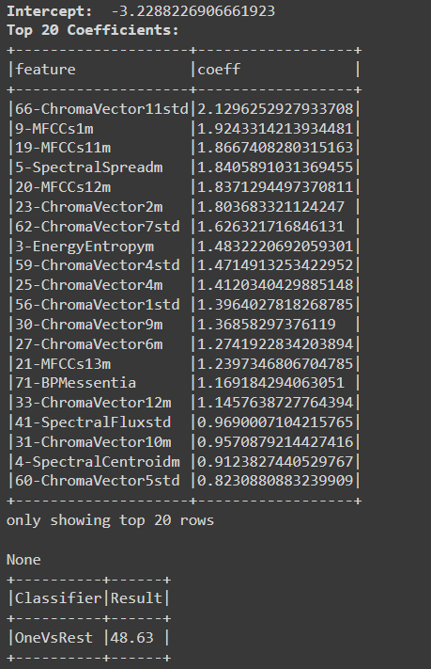
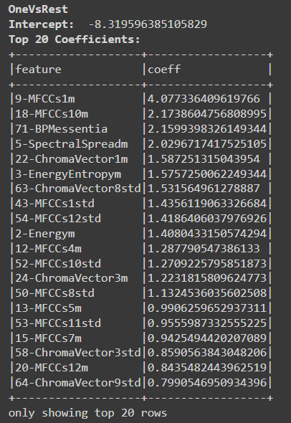
Final Model Training and User Recommendation
Training the Final Model with Optimal Features
Feature Selection: Utilized ChiSqSelector to select the top 71 features most relevant for classification.
Data Preparation: Adjusted the DataFrame to ensure compatibility with classifiers by renaming the selected features back to "features".
Model Evaluation
Classifier: Implemented OneVsRest logistic regression model to classify each genre.
Performance Evaluation: Results displayed
using a dynamic results DataFrame.

Slide 14
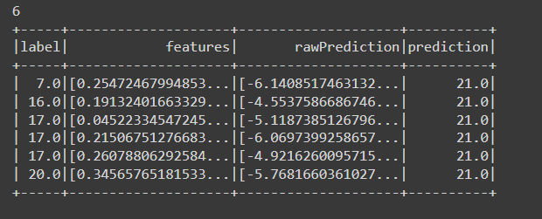
Application: Making a Recommendation
Context: The model has been deployed in an online radio station’s next version, influencing song selection in various stations.
Model Deployment: The model identifies potential new song additions for specific music genres.
User Recommendation:
Detected a new affiliation for the genre BigRoom (now labeled as 21.0).
Counted and displayed songs incorrectly classified as BigRoom but belonging to other genres, suggesting their suitability for BigRoom based on their features.

Slide 15
Thank You!

